Slide 1
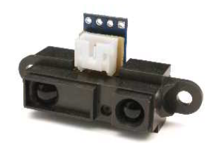
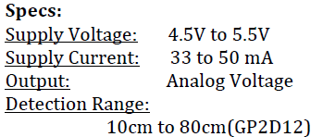

Sharp IR Range Finder GP2D12

Slide 2
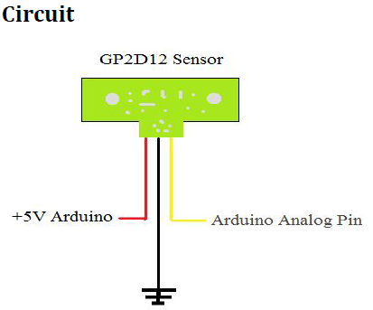
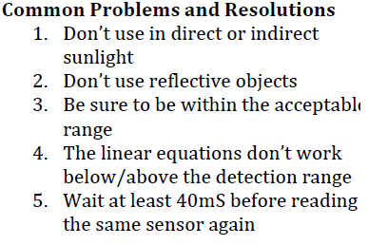
Volts(Digital Output(DEC)) = (Analog Reading * (1024/5))

